Slide 1
Government Price Controls: Price Floors
Steven Suranovic
George Washington University

Slide 2
Types of Government Price Controls
Price Ceiling (L20) – a maximum price that can be charged for a product in a market
Price Floor (L21) – a minimum price that can be charged for a good or service in a market
Best example – Minimum wage laws
Price Support (L22) – a price floor for a good in which the government purchases excess supply

Slide 3
Price Floor Intentions
Achieve more of a “living wage” for low income workers
Living wages are defined as those necessary to support a household
Reduce inequality by raising lowest incomes
Substitute for Unionization
Note Trade Unions act to bargain for higher wages for all of a company’s employees

Slide 4
Recent Minimum Wage Legislation
Current Federal Minimum Wage
$7.25 per hour
Same since 2009
Recent State Level Actions
Maryland: $15 by 2026
California: $12 by 2019
Illinois: $15 by 2025
New York: $15 by 2021
DC: $15 by 2020
President Obama proposes in 2013 an increase to $10.10 nationally
Never passed

Slide 5
Recent Minimum Wage Legislation
Recent City Level Actions
Los Angeles: $14.25 for > 26 employees
Mountain View, CA: $15.65
San Francisco: $15.59
New York City: $15
Seattle: $16 by 2021
Recent Corporate Actions
Amazon, Target: $15
Costco: $15
WalMart: $18
Starbucks: $9.09
Bank of America: $20

Slide 6
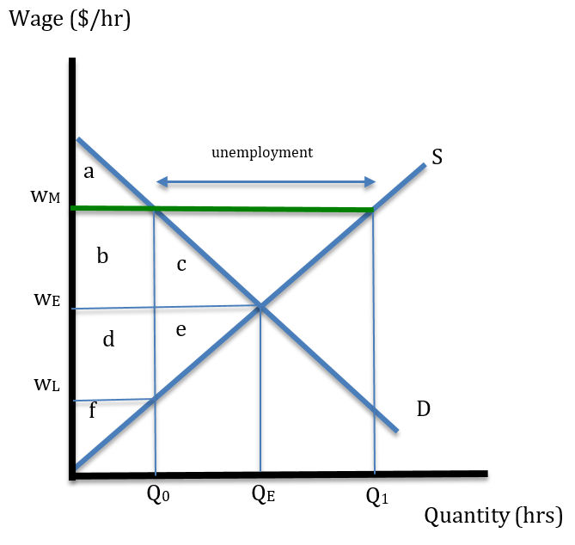
Effects of a Minimum Wage in a Labor Market
Workers supply their labor in the market while firms demand labor services
Supply (workers): Demand (Firms)
Producer surplus is worker well-being
Consumer surplus is firm well-being

Slide 7
Effects of a Minimum Wage in a Labor Market
Let w_{M} be the minimum wage
Q₁ is the quantity of labor supplied by workers at w_{M}
Q₀ is the quantity of labor demanded by firms
Q₁ – Q₀ = excess supply of labor = unemployment (quantity of workers who want to work but are not hired)

Slide 8
Effects of a Minimum Wage in a Labor Market
Welfare Effects of a Minimum Wage
ΔCS (firms) = - (b + c)
Firms lose because their costs increase
ΔPS (workers) = b – e
Some workers gain with higher wages but others lose their jobs
ΔMW = - c – e (deadweight losses)
Overall, the policy reduces market welfare which means happiness is reduced

Slide 9
Effects of a Minimum Wage in a Labor Market
Differential Impacts
Employed workers in the range (0 , Q₀) earn the higher wage (more likely the most productive workers)
Unemployed workers in the range (Q₀ ,Q_{E}) lose their jobs (more likely the least productive workers)
Unemployed workers in the range (Q_{E} , Q₁) enter the market but do not get jobs

Slide 10
Effects of a Labor Union in a Labor Market
The min wage result is identical to a labor union in an industry
Collective Bargaining used to get a better deal for workers
Higher wages, better working conditions, more time off, increase difficulty for firing
Unionization in the US - ~ 10% of workforce
Down from 20% in 1983
Union workers are paid ~20% more than non-union
Private sector rate = 6% ; Public sector rate = 34%
Public sector pensions and unfunded liabilities

Slide 11
Effects of a Labor Union in a Labor Market
A labor union seeks to secure higher wages for its workers
If a union bargains for a higher wage w_{M}, then it is like instituting a min wage for the firm
Firms will respond by cutting the number of jobs to Q₀

Slide 12
Effects of a Labor Union in a Labor Market
Welfare Effects of a Union
Union workers who work gain
Workers who are unemployed lose
Total impact of unionization in a PC market is a loss of economic efficiency, same as Min wage
Extra earnings used to pay union dues which in turn used for lobbying efforts

Slide 13
Effects of a Labor Union in a Labor Market
A Labor Union takes advantage of a monopoly position by cutting supply and raising the price
Unions must discourage scabs or strikebreakers. Scabs increase labor competition and destroys their monopoly
Government legalization of unions effectively creates labor monopoly power – similar to intellectual property rights which give producers monopoly power

Slide 14
Effects of a Min Wage/Union in a Labor Market
Why do so many support a policy that is likely to cause more harm than good?
Most people haven’t heard the economic argument
Simple argument is convincing … i.e.,raise wages, or unionize, and everyone makes more money
Seems compassionate
For min wage support, many labor union contracts have wages tied to the minimum wage, so if the min wage rises, lots of non-min wage union workers get raises
This feature inspires a lot of political support for these policies.

Slide 15
Effects of a Min Wage/Union in a Labor Market
Why do so many economists support a policy that is likely to cause more harm than good?
Empirical evidence is mixed
Card and Krueger NJ study (1990s) shows an increase in employment after a min wage increase
Uses a more sophisticated natural experiment – compared NJ with PA for results
But, considers only a small increase in min wage … may not apply to large increases
Many other studies do show employment decreases from min wage
many of these are not natural experimental designs though
Controversy continues – empirical evidence is insufficient so far

Slide 16
Effects of a Min Wage/Unions in a Labor Market
Why do so many economists support a policy that is likely to cause more harm than good?
Firms have monopoly power enabling higher firm profit … Min wage/unions shift those profits to the workers (doesn’t apply to government unions)
Firms have a monopsony (single buyer) in labor markets
Argument 1: Monopsony is unlikely since there are many job opportunities for low wage workers in retail, factories etc. there is lots of competition
Argument 2: job immobility is high → monopsony power
lack of info; switching costs, non-compete clauses; no-poaching agreements

Slide 17
Effects of a Minimum Wage with Monopsony
Monopsony means a single buyer (firms demanding labor in this case)
To maximize profit a monopsony firm could lower the wage to w_{L} and lower employment to Q₀
Since workers can't work elsewhere they have no choice but to accept lower wage
Fewer workers work at low wage
CS (to the firm) = (a + b + d)
PS (to the workers) = f
MW = a + b + d + f

Slide 18
Effects of a Minimum Wage with Monopsony
A minimum wage @ w_{E} would force the monopsony firm to increase the wage (w_{L} to w_{E}) and employment to (Q₀ to Q_{E})
In this case a minimum wage would not cause unemployment. Instead,
worker wages rise
Total employment increases
Economic efficiency improves to MW = (a + b + c + d + e + f)

Slide 19
Effects of a Min Wage/Union in a Labor Market
Why do so many economists support a policy that is likely to cause more harm than good?
This position is tenable if the policy (min wages/union) is eliminating monopsony power. In this case, the policy achieves a more efficient economic outcome
But is the low wage labor market really monopsonistic?
Competition in the labor market depends on free entry and exit in response to profit
Workers “profit” from the wage, safety, working conditions, friendliness of coworkers, etc. in a firm
If worker profit is not positive, workers should leave to find a better opportunity
Firms must keep work profitable for workers or the best ones will leave

Slide 20
Secondary Impacts of Minimum Wages
Effects on Final Product Prices (eg. Fast food, retail prices, etc.)
Higher input price (due to min wage/union) raises AC and MC for competitive firms
Short-run supply shifts up/left
Product prices rise; output falls in Short-run (prices at Walmart, fastfood, etc)
Profits become negative → Exit of firms (some firms are not profitable with higher wages)
In the long-run product prices remain higher because min AC is higher in the long-run.
There is a ripple effect to the rest of the economy (general equilibrium)

Slide 21
Secondary Impacts of a Min Wage/Union
Effects on Final Product Prices (eg. Fast food, retail prices, etc.)
Higher input price (due to min wage/union) raises AC and MC for competitive firms
Short-run supply shifts up/left
Product prices rise; output falls in Short-run (prices at Walmart, fastfood, etc)
Profits become negative → Exit of firms (some firms are not profitable with higher wages)
In the long-run product prices remain higher because min AC is higher in the long-run.
There is a ripple effect to the rest of the economy (general equilibrium)

Slide 22
Secondary Impacts of a Min Wage/Union
Capital Substitution
McDonald’s installs self-serve kiosks
Self-checkout at major stores
Driverless taxi and delivery services (still to come)
Cheating/Avoidance of Minimum Wages
Cannot cheat legal workers → may inspire complaints
Can cheat with illegal workers → no complaints

Slide 23
Secondary Impacts of a Min Wage/Union
Effects on Internships (see readings)
Interns are not supposed to do substantive work that a firm might hire someone to do
Pressure to force employers to pay interns
Likely effect on the number of available internships??
Other articles about min wages in Lecture Notes
Race, Politics and the Minimum Wage (2011)
The Business of the Minimum Wage (2013)

Slide 24
Conclusions
Minimum wage laws and unionization have mixed effects – there are both winners and losers that arise
In perfectly competitive markets, these actions cause more harm than good – the losses to the losers exceeds the gains to the winners
Empirical evidence is currently mixed and inconclusive
Minimum wage laws and unionization have net positive effects if the labor market is monopsonistic
Economists who support these laws are seeking empirical evidence to argue that labor markets are monopsonistic … only weak evidence so far
These policies likely to remain controversial.

